Slide 1
Polymorphism Session 8
Course : COMP 6175
Object Oriented Programming
Effective Period : October 2018

Slide 2
Outline
- Introduction - Overriding
- Abstract Base Class - Ad hoc Polymorphism - Parameterized Polymorphism

Slide 3
Introduction of Polymorphism
Polymorphism is a generic term that means “Many shapes”.
Object oriented programming concept to refer to the ability of a variable, function, or object to take on multiple forms.
Two useful terms, subtype and supertype.
Subtype: a class defines a type, a type defined by a subclass is subtype.
Supertype: a type defined by its supefclass.

Slide 4
Polymorphism Types
There are two type of polymorphism based on its lifetime:
Trivial Polymorphism: Overloading
Handle when compile
Static binding
Pure Polymorphism: Overriding
Handle at runtime
Dynamic binding

Slide 5
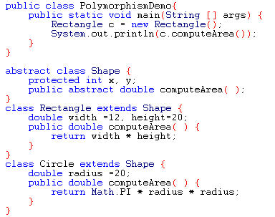
Polymorphism Example
ComputeArea() function is a polymorphism method from class Shape which overridden in class Rectangle and Circle .

Slide 6
Polymorphism Types (Cont.)
There are two types of Polymorphism based on time:
Static (Compile Time), can through:
Generic
Overload
Dynamic (Run Time), can through:
Class
Inheritance
Abstract
Interface

Slide 7
Ad hoc Polymorphism
Ad hoc polymorphism refers to polymorphic functions that can be applied to different argument types known by the same name in a programming language. Ad hoc polymorphism is also known as function overloading or operator overloading because a polymorphic function can represent a number of unique and potentially heterogeneous implementations depending on the type of argument it is applied to.

Slide 8
Ad hoc Polymorphism
1 + 2 = 3
3.14 + 0.0015 = 3.1415
The symbol ‘+’ is used in two different ways.
In the expression a+b, it stands for the function that adds two integers.
In the expression x+y, it stands for the function that adds two floats.
Ad hoc polymorphism refers to the use of a single function name to indicate two or more unique functions. The compiler decides which function to call depending on the type of arguments. Ad hoc polymorphism is supported by almost all programming languages for built-in operations such as ‘+’, ‘-‘, ‘*’, etc.

Slide 9
Parameterized Polymorphism
Parametric polymorphism is the core principle behind generic programming languages and structures. It enables the creation of generic functions and data types that operate on values, regardless of data type.
For example, if a programming function operates on two different values, the values may be attached, even though they do not have the same data types. An example is joining a list of integers with a floating point value.
3.2 + 3 = 6.2

Slide 10
References
Daniel Liang, Y., 2015, Introduction to java programming, vol.10, Pearson Education, New Jersey.
Polymophism
http://www.uweb.ucsb.edu/~cdecuir/Polymorphism.html
Polymorphism in Object Oriented Programming
http://en.wikipedia.org/wiki/Polymorphism_in_object-oriented_programming

